Slide 2
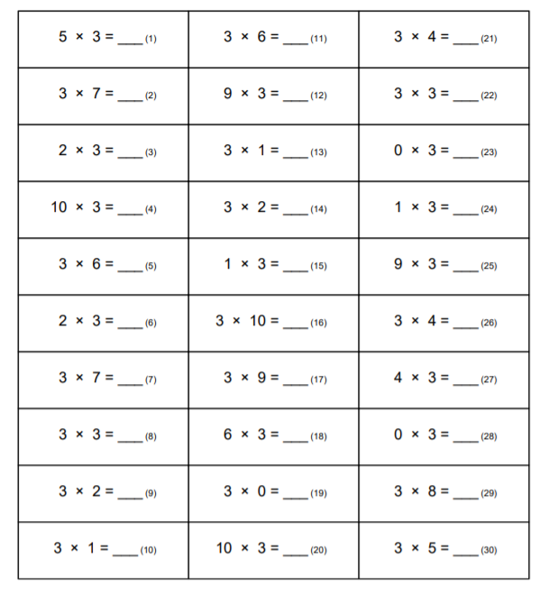
Have a go at these. See how quickly you can do them.
You might want to keep a copy of this to keep practicing with.

Slide 4
Is this true or false?
How can you prove it? Use drawings or a bar model to help you.

Slide 5
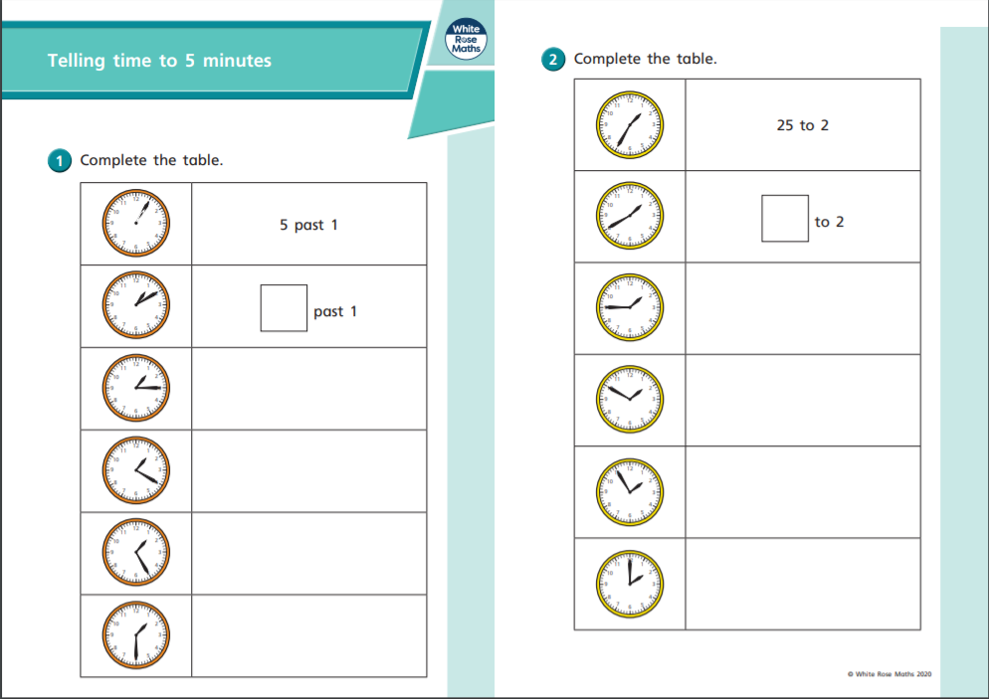
Maths
LO: To tell the time to the nearest 5 minutes.

Slide 6
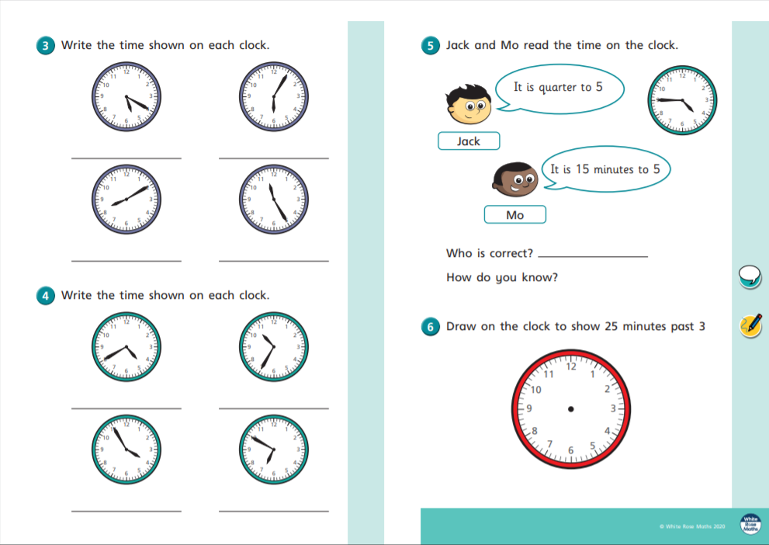
LO: To tell the time to the nearest 5 minutes.

Slide 7
English
LO: To be able to give an explanation.
Today I would like you to complete pages 15 of the booklet.
Make sure to give a full explanation.
Tell me about your favourite game, who do you like to play it with?
Why do you like it so much?
Which games have you never played but would like to?

Slide 8
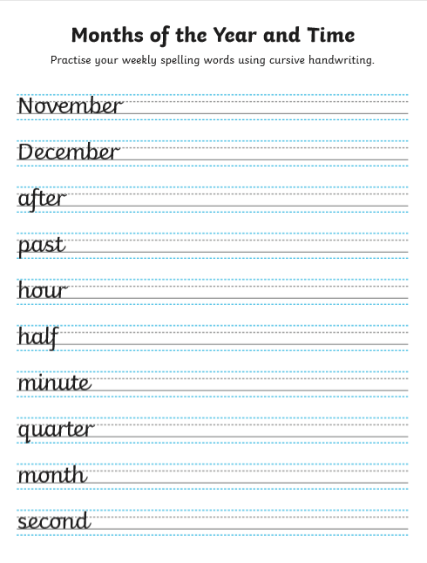
Remember to keep your letters even. Try and make each days work better than the day before.

Slide 9
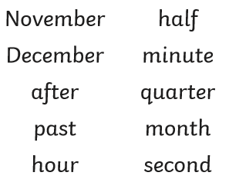
I’m sure you’re getting so much better with this weeks spellings.
Keep going!

Slide 10
Our writing checklist
Capital letters and full stops
Finger spaces
Adjectives
Question and exclamation
Connectives
Commas in lists
Capitals for names, dates and places
Wow words
Time connectives

