Slide 1
Home Learning Tuesday 31st March
Good morning

Slide 2
Tuesday 31st March L.O. – to convert mixed numbers to improper fractions
Maths
Can you remember the difference between a mixed number and an improper fraction?
A mixed number is a whole number and a fraction
e.g. 2 $\frac{1}{3}$
An improper fraction is a fraction where the numerator is larger than the denominator
e.g. $\frac{12}{3}$
Remember:
To convert between an improper fraction and a mixed number look at the denominator.
Ask yourself how many make one whole.
For example:
$\frac{15}{4}$ - how many 4s in 15?
3 $\frac{3}{4}$
15 ÷ 4= 3 r 3

Slide 3
Fun Challenge

Slide 4
Fantastic Challenge

Slide 5
Fabulous Challenge

Slide 6
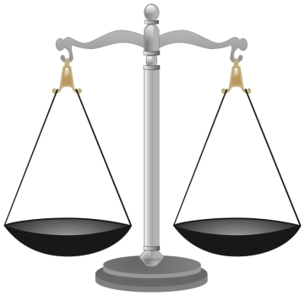
Tuesday 31st March L.O. – to plan my discussion
English
We have already done a lot of work on writing a discussion this term.
Today, I would like you to plan your hot task which you will be writing tomorrow.
You may want to explain to someone at home what a cold and hot task is!
Do you remember the recent discussion we had in class about the idea to build a new town near Great Chesterford?
Each table was given a group to represent. You discussed your main ideas and then we had a mock village meeting to hear the different points of view.

Slide 7
Here are some of the points of view you may want to think about; there may be others.

Slide 8
L.O – to plan a discussion
Remember –it is not just about what you think .
A good piece of discussion writing should be balanced.
Before you start – why not have a discussion with someone at home on this subject? Try to see both sides of the argument.
Now draw a table in your book and make detailed notes for tomorrow’s hot task.
Should a new town be built near Great Chesterford?
Points For Points Against

Slide 9
Keeping in touch
If you can, send me a screenshot of your work
I will post the answers to Maths challenges the day after they were set so that you can mark what you have done
If you have any questions about your work, send me an email
Let me know what you have been doing to keep active

