Slide 1
Wednesday 8th July
Good morning Year 4 – it’s hump day!
We’re looking forward to see you this afternoon on Zoom.
Yesterday’s Trivia Answer
The capital city of Greece is Athens.
Today’s Trivia Question
What currency do they use in Greece?
Don’t forget to try out the Quad Kids competition! The information can be found on the website.
The deadline is 12th July.

Slide 2
Yesterday’s Maths Starter
Today’s Number: 1053
Write it in words: One thousand and fifty three
5 less: 1048
20 more: 1073
Add 351: 1404
Round to the nearest 100: 1100
Divisible by 5? No
Divide by 100: 10.53
Double it: 2106

Slide 3
Yesterday’s Answer
210 ÷ 10 = 21 3000 ÷ 10 = 300
270 ÷ 10 = 27 27 ÷ 100 = 0.27
3 ÷ 10 = 0.3 7 ÷ 10 = 0.7
300 ÷ 100 = 3 21 ÷ 100 = 0.21
0.1 keys | 0.03 friendly | 0.7 mischievous | 27 creature | 0.3 is | 3000 primate | 2.1 noisy | 21.7 leaves
0.27 monkey | 21 a | 30 seeds | 300 very | 3 the | 0.07 screeches | 0.027 fruit | 0.21 sociable
The mischievous monkey is a very sociable creature.

Slide 4
Maths Starter
Today, you will need to draw a number line from -13 to 13, find a counter and two 1-6 dice to use. Ideally, this is a game for two players but you can play it on your own too.
First, decide who is positive and who is negative. If you’re playing alone, you need to choose which you think will be the winner (positive or negative). Positive moves the counter from left to right and negative moves the counter from right to left. Why do you think it is this way round?
Begin by placing the counter on 0 (the picture above shows a red counter). Next, take it in turns to throw the two dice, add the scores and then move the counter that number of places in your direction. If the counter reaches -13, negative has won. If the counter reaches 13, positive has won.
Now change the game. This time, when you throw the dice, you can decide whether to add, subtract, multiply or divide the numbers on the dice. You must reach -13 or 13 exactly to win. Does this make a better game? Why?

Slide 5
Clue 3 – Along the landing and up the stairs
Those cheeky monkeys have hidden the next clue in the coordinates. Use the grid on the next page to solve the third clue.

Slide 6
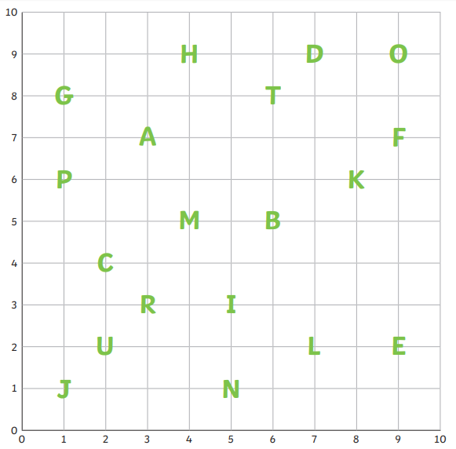

Slide 7
English
Spellings
Write out a row of the spellings below. Make sure your handwriting is joined, sitting on the line and has clear ascenders and descenders.
eight
neighbour
weight
freight
Spelling Bonus
Write the words out in rainbow lettering.

Slide 8
English – Mission Possible
We’ve spent time thinking about characters so now we need to think about the settings for stories.
Complete the box at the top of page 22. How many different settings can you list? 15? 20? More? They might be specific places (such as London) or they may be more general (a forest).
Now fill in the thought bubbles for different possible settings. They might be normal/everyday places, scary locations or interesting/unusual settings.

