Slide 1
Friday 3rd April
Good morning Class 4. It’s Friday today, which means it’s the last day before the Easter holidays.
The following slides cover the home learning tasks for today. Don’t forget to include the date and learning objective on your work. If you have any questions or would just like to let us know what you’ve been doing to keep yourself busy, please email:
Year4@greatchesterford.essex.sch.uk
It’s been good to hear that some of you have also been baking – lemon drizzle cakes, orange chocolate chip cakes, cookies – delicious!
We will also be posting a Lower Key Stage 2 Easter Bingo challenge to the class page to keep you busy during the Easter holiday. Can you get a line or a full house?
Happy home learning!

Slide 2
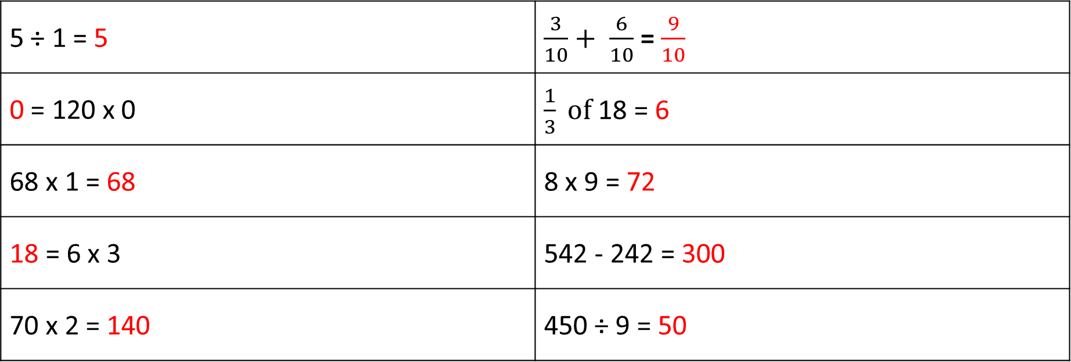
First, the answers from yesterday…
Maths warm up
5 ÷ 1 = 5 | $\frac{3}{10}+ \frac{6}{10}$ = $\frac{9}{10}$
0 = 120 x 0 | $\frac{1}{3} of$18 = 6
68 x 1 = 68 | 8 x 9 = 72
18 = 6 x 3 | 542 - 242 = 300
70 x 2 = 140 | 450 ÷ 9 = 50

Slide 3
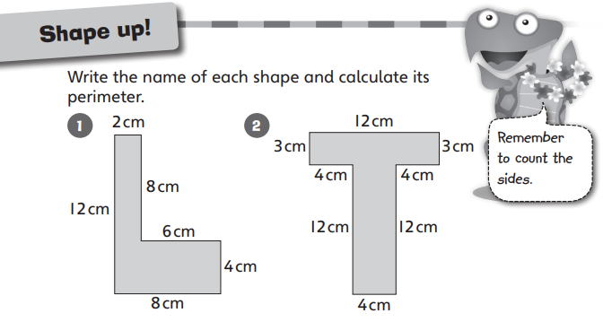
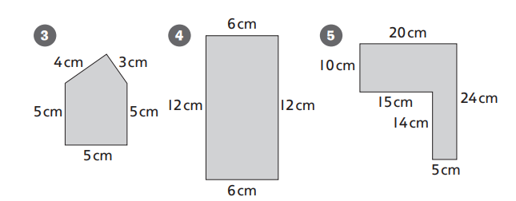
Calculating the perimeter
Did you remember to write the units of measurement for the perimeters?
Hexagon 12 + 2 + 8 + 6 + 4 + 8 = 40cm
Octagon 12 + 3 + 4 + 12 + 4 + 12 + 4 + 3 =54cm
Pentagon 4 + 3 + 5 + 5 + 5 = 22cm
Rectangle 6 + 12 + 6 + 12 = 36cm
Hexagon 20 + 24 + 5 + 14 + 15 + 10 = 88cm

Slide 4
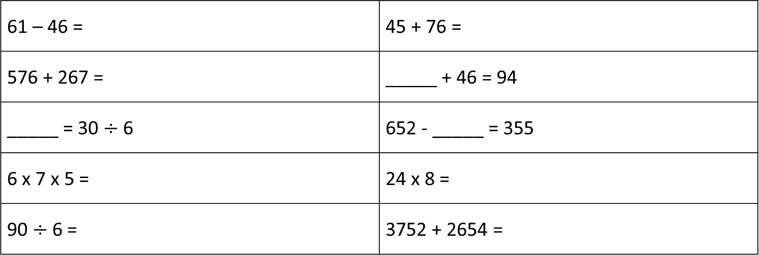
Friday’s Maths warm up
To get your brain into gear, have a go at these questions.
Answers are at the end of the slides.
61 – 46 = | 45 + 76 =
576 + 267 = | _____ + 46 = 94
_____ = 30 $÷$ 6 | 652 - _____ = 355
6 x 7 x 5 = | 24 x 8 =
90 $÷$ 6 = | 3752 + 2654 =

Slide 5
Maths
Cut and Make Investigation
LO: To investigate making different shapes.
Take a square of paper, fold it in half from corner to corner and cut along the fold.
Take one of the triangles, fold it in half and cut along the fold.
Can you use all three pieces to make a large triangle and a parallelogram? What other shapes can you make with all three pieces? Record your shapes in your home learning book.

Slide 6
English
First of all, mark you comprehension questions from yesterday:
The Vikings first arrived in Britain in AD 787.
The Vikings chose to come to Britain for the land and new things to steal and sell.
A monastery is a building where monks live under religious vows.
The Vikings first raided Lindisfarne in Northumberland. They stole valuable things from the monastery.
The Vikings wanted to settle permanently in Britain because of the mild climate and the rich natural resources.
The Vikings took over York in AD 866.
King Alfred the Great was King of Wessex. He fought against the Vikings but lost and went into hiding.
The Vikings made good warriors because they were excellent fighters, very organised and they were brave in battle.
Responses could include: axe, spear, sword or shield, with a sensible reason for your choice.
Viking warriors believed they went to Valhalla, which was their idea of heaven.

Slide 7
English
Write out a row of your weekly spellings in your neatest joined handwriting (purpose, quarter, sentence, therefore).
LO: To write complex sentences.
You are going to play a game which will help you to practise writing complex sentences.
You will need:
scissors, glue, pencil, home learning book, someone to play with and a timer
The instructions are on the next slide.

Slide 8
How to Play
Carefully, cut out the nets on the next slides. Fold them carefully and stick the tabs down to make two dice.
Cut out and place all the topic cards (on the next slides) in a pile face down on the table.
Decide who will be player one. They choose a topic card and roll one of the dice. They have two minutes to write down a complex sentence on the topic using that particular subordinating conjunction/relative pronoun.
For example, if you picked up the topic card that said ‘football’ and you rolled one of the dice and got ‘since’, you could write…
Since the goalkeeper seemed unable to catch the ball, he was dropped from the team.
Or
The goalkeeper was dropped from the team since he was unable to catch the ball.
Notice how if the subordinate clause comes first, a comma is needed but if the main clause comes first, a comma is not needed.

Slide 9
How to Score
If the player manages to create a sensible complex sentence with correct punctuation (capital letter, full stop and comma if needed) within the given time, they are awarded a point.
Play passes over to the next player. The first player to six points wins.
If you want to send me your sentences, maths investigations or any other news, please email them to Year4@greatchesterford.essex.sch.uk
Good luck!

Slide 10
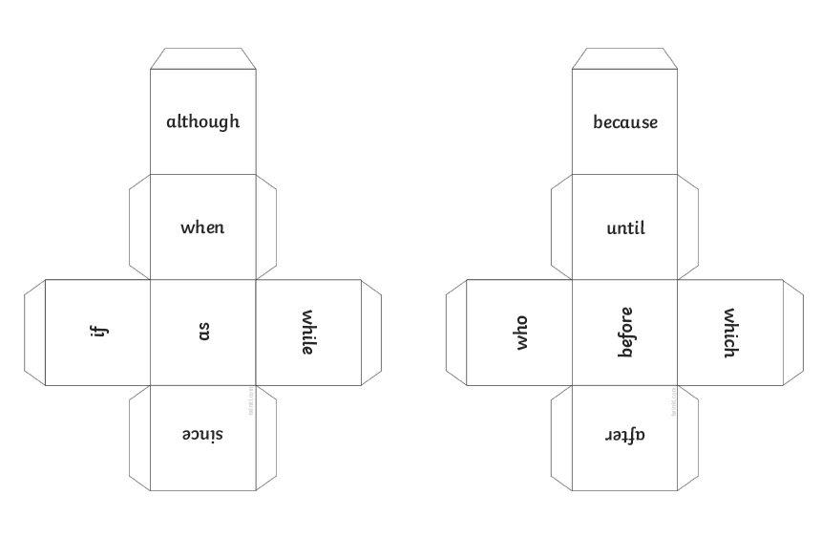
Dice

Slide 11
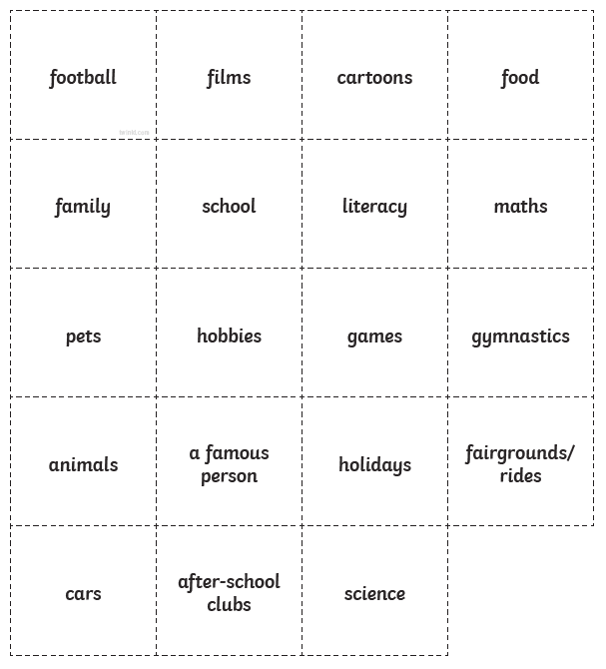
Topic Cards

Slide 12
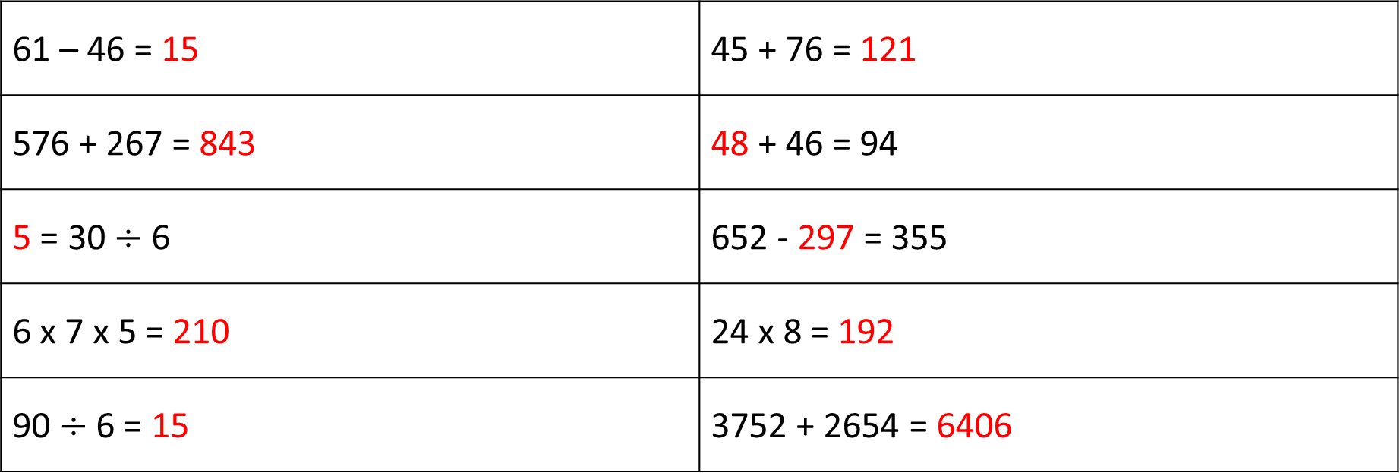
Today’s Maths warm up - Answers
61 – 46 = 15 | 45 + 76 = 121
576 + 267 = 843 | 48 + 46 = 94
5 = 30 $÷$ 6 | 652 - 297 = 355
6 x 7 x 5 = 210 | 24 x 8 = 192
90 $÷$ 6 = 15 | 3752 + 2654 = 6406

