Slide 1
Home Learning Class One Maths 24.3.20

Slide 2
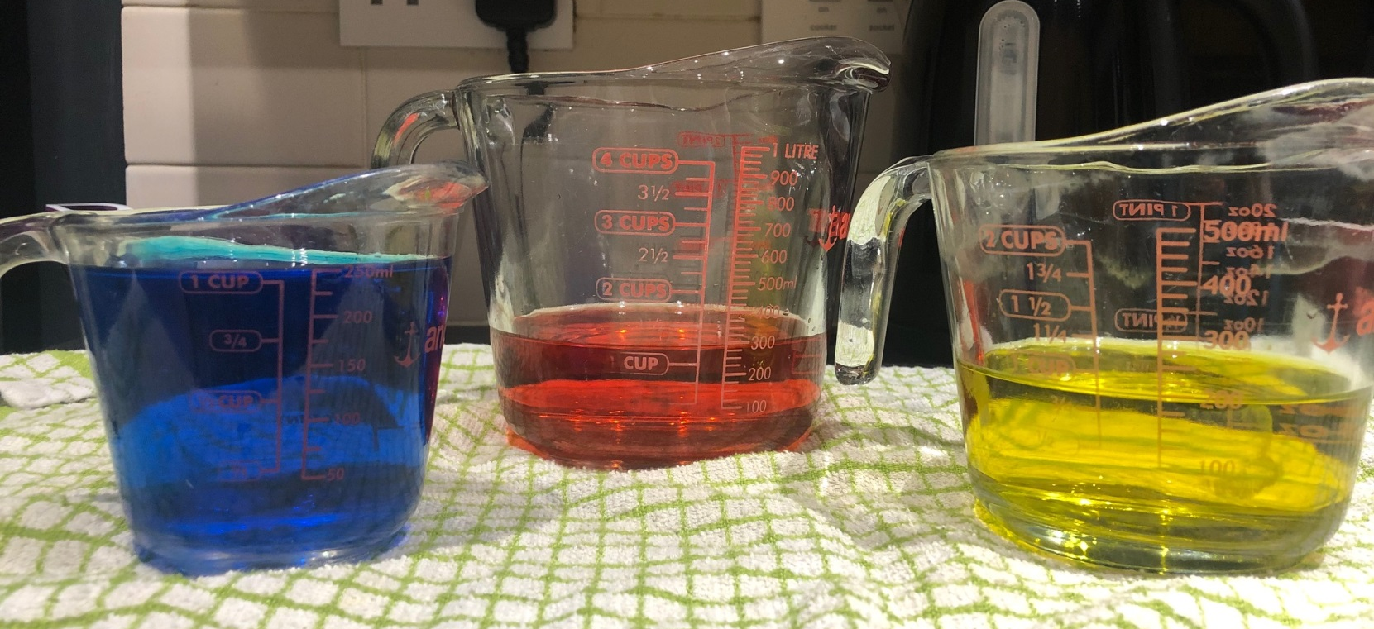
Look at these three jugs….which do you think has the most water in it? Talk to someone about your ideas.
Checkpoint: Is your child confidently using vocabulary such us full, half full, more than, less than?
For some children this will need more practice, if so, a practical activity with jugs and containers would be perfect to give your child an opportunity to use mathematical vocabulary related to volume.

Slide 3
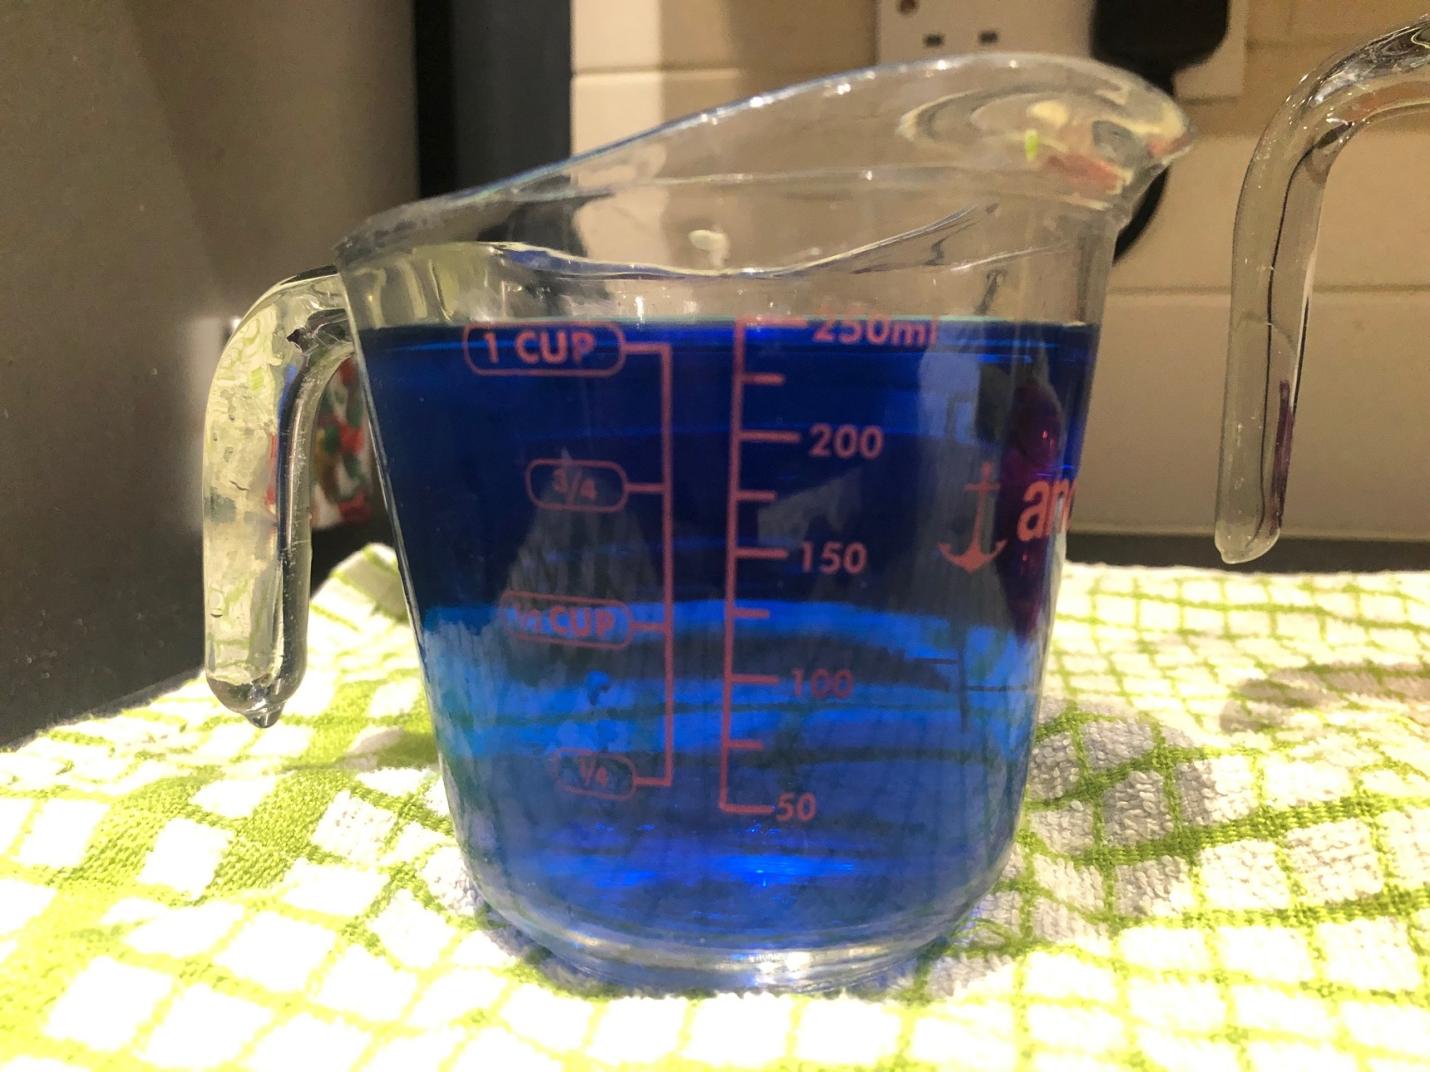
Look carefully at the scale, how much water is in this jug?

Slide 4
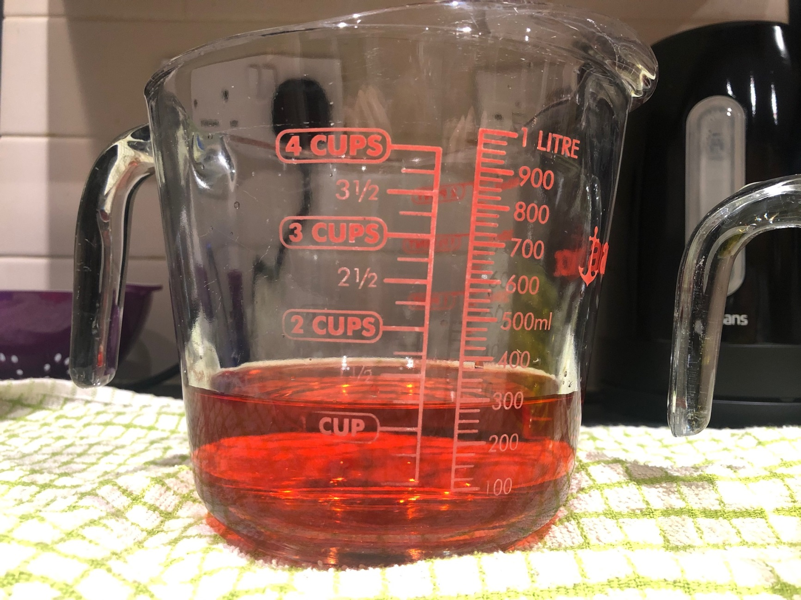
Look carefully at the scale, how much water is in this jug?

Slide 5
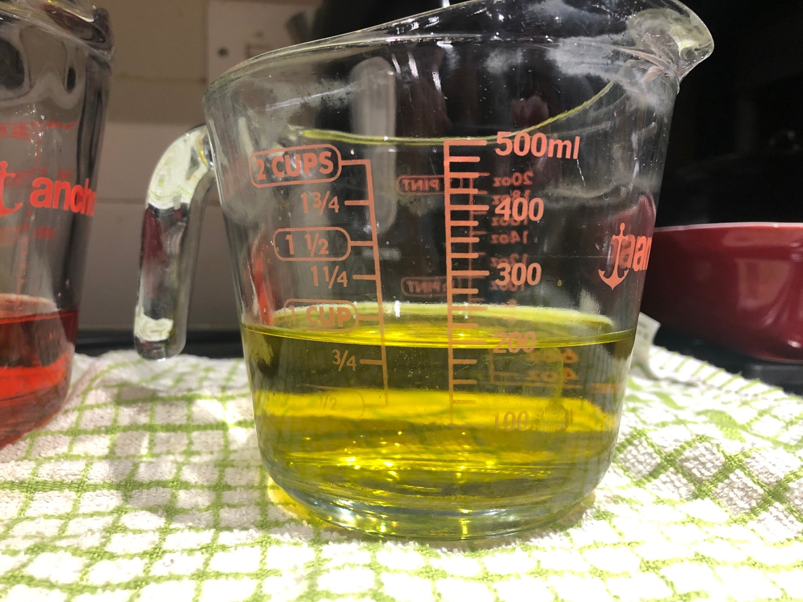
Look carefully at the scale, how much water is in this jug?

Slide 6
Checkpoint: Can your child confidently read a labelled scale on a jug? If your child needs more practise with this give them an opportunity to read scales on jugs and containers. This is a good way to reinforce counting in 2’s, 5’s and 10’s as well.
E.g.. How much is in these jugs? How do you know?
If you’re able to do it with real jugs – even better.

Slide 7
If your child can confidently read a labelled scale on a jug and use mathematical vocabulary to describe the amount of liquid in a container then please ask them to complete these questions in their home learning book.
If I poured the contents of all three jugs into one container, how much water would I have? Write out a number sentence.
I am going to make half a litre of custard, which jug should I use? Explain your idea.
Sue poured out 150ml of the blue water. How much is left in the jug? Write out a number sentence.
Pete wants to try and make green. Is there enough space left in the yellow jug for him to pour all the blue liquid in? Explain how you know.

