Slide 1
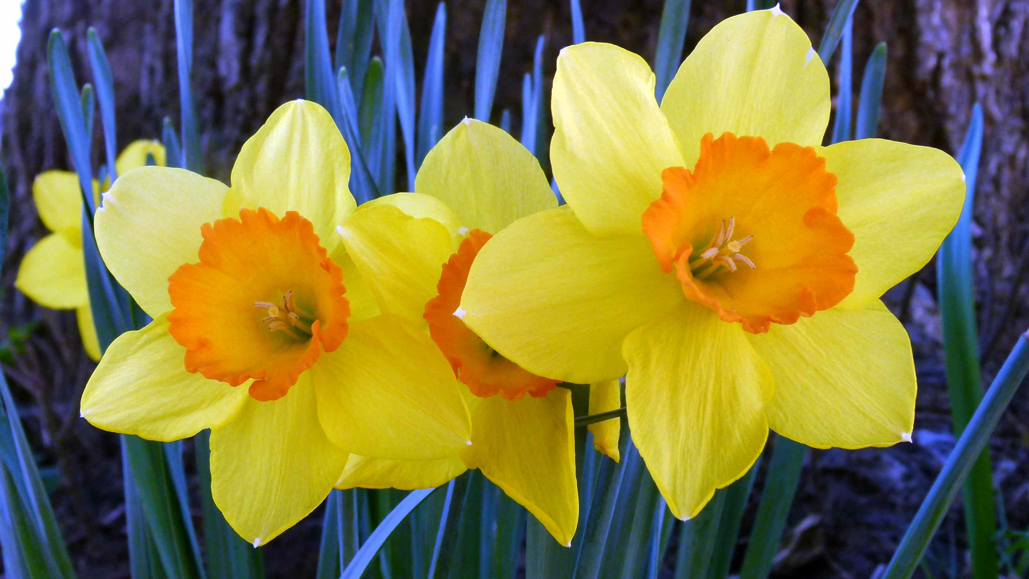
Home Learning Tuesday 31st March
Good morning Class 3!

Slide 2
Thursday 26th March
Dear class 3,
Please read our collection of fabulous fables which is now on the class page. Well done everyone!
Today, as a maths starter activity, we would like you to spend 15 minutes on’ Hit the button’- number bonds games.
https://www.topmarks.co.uk/maths-games/hit-the-button
Now try the adding 3 numbers work on the next slides. Choose one of the challenges.
In class recently, we discussed choosing the best strategies to re order and then to add 3 numbers. We would like you to become fluent in doing this.
Methods we agree you should try to use are:
Re ordering the numbers- putting the largest number first, if it is helpful
Looking for doubles 6+6 =13
Looking for near doubles 6+7 =13
Looking for number bonds 3+7=10 or 13+7=20
Try not to count on your fingers as it is important that you learn these strategies.
Mrs Langton and Mrs Raper

Slide 3
Tuesday 31st March
L.O. Mentally add 3 numbers using appropriate methods.
Daffodil Challenge
7. 3 +6 +6=
8. 9 + 7 +9=
9. 6 +12 +8=
10. 4 +5 +11=
11. 1+ 11+ 9=
12. 2+ 3 +17=
1. 4 + 6 + 8=
2. 8 + 7+ 4=
3. 6 + 9+ 4=
4. 5 +7+ 15 =
5. 2 +7 + 18 =
6. 14 +2 +6 =
13. Which sums did you find easiest?
14. Which sums were hardest?
15. Which method did you use most?
16. Which method do you need to practise?

Slide 4
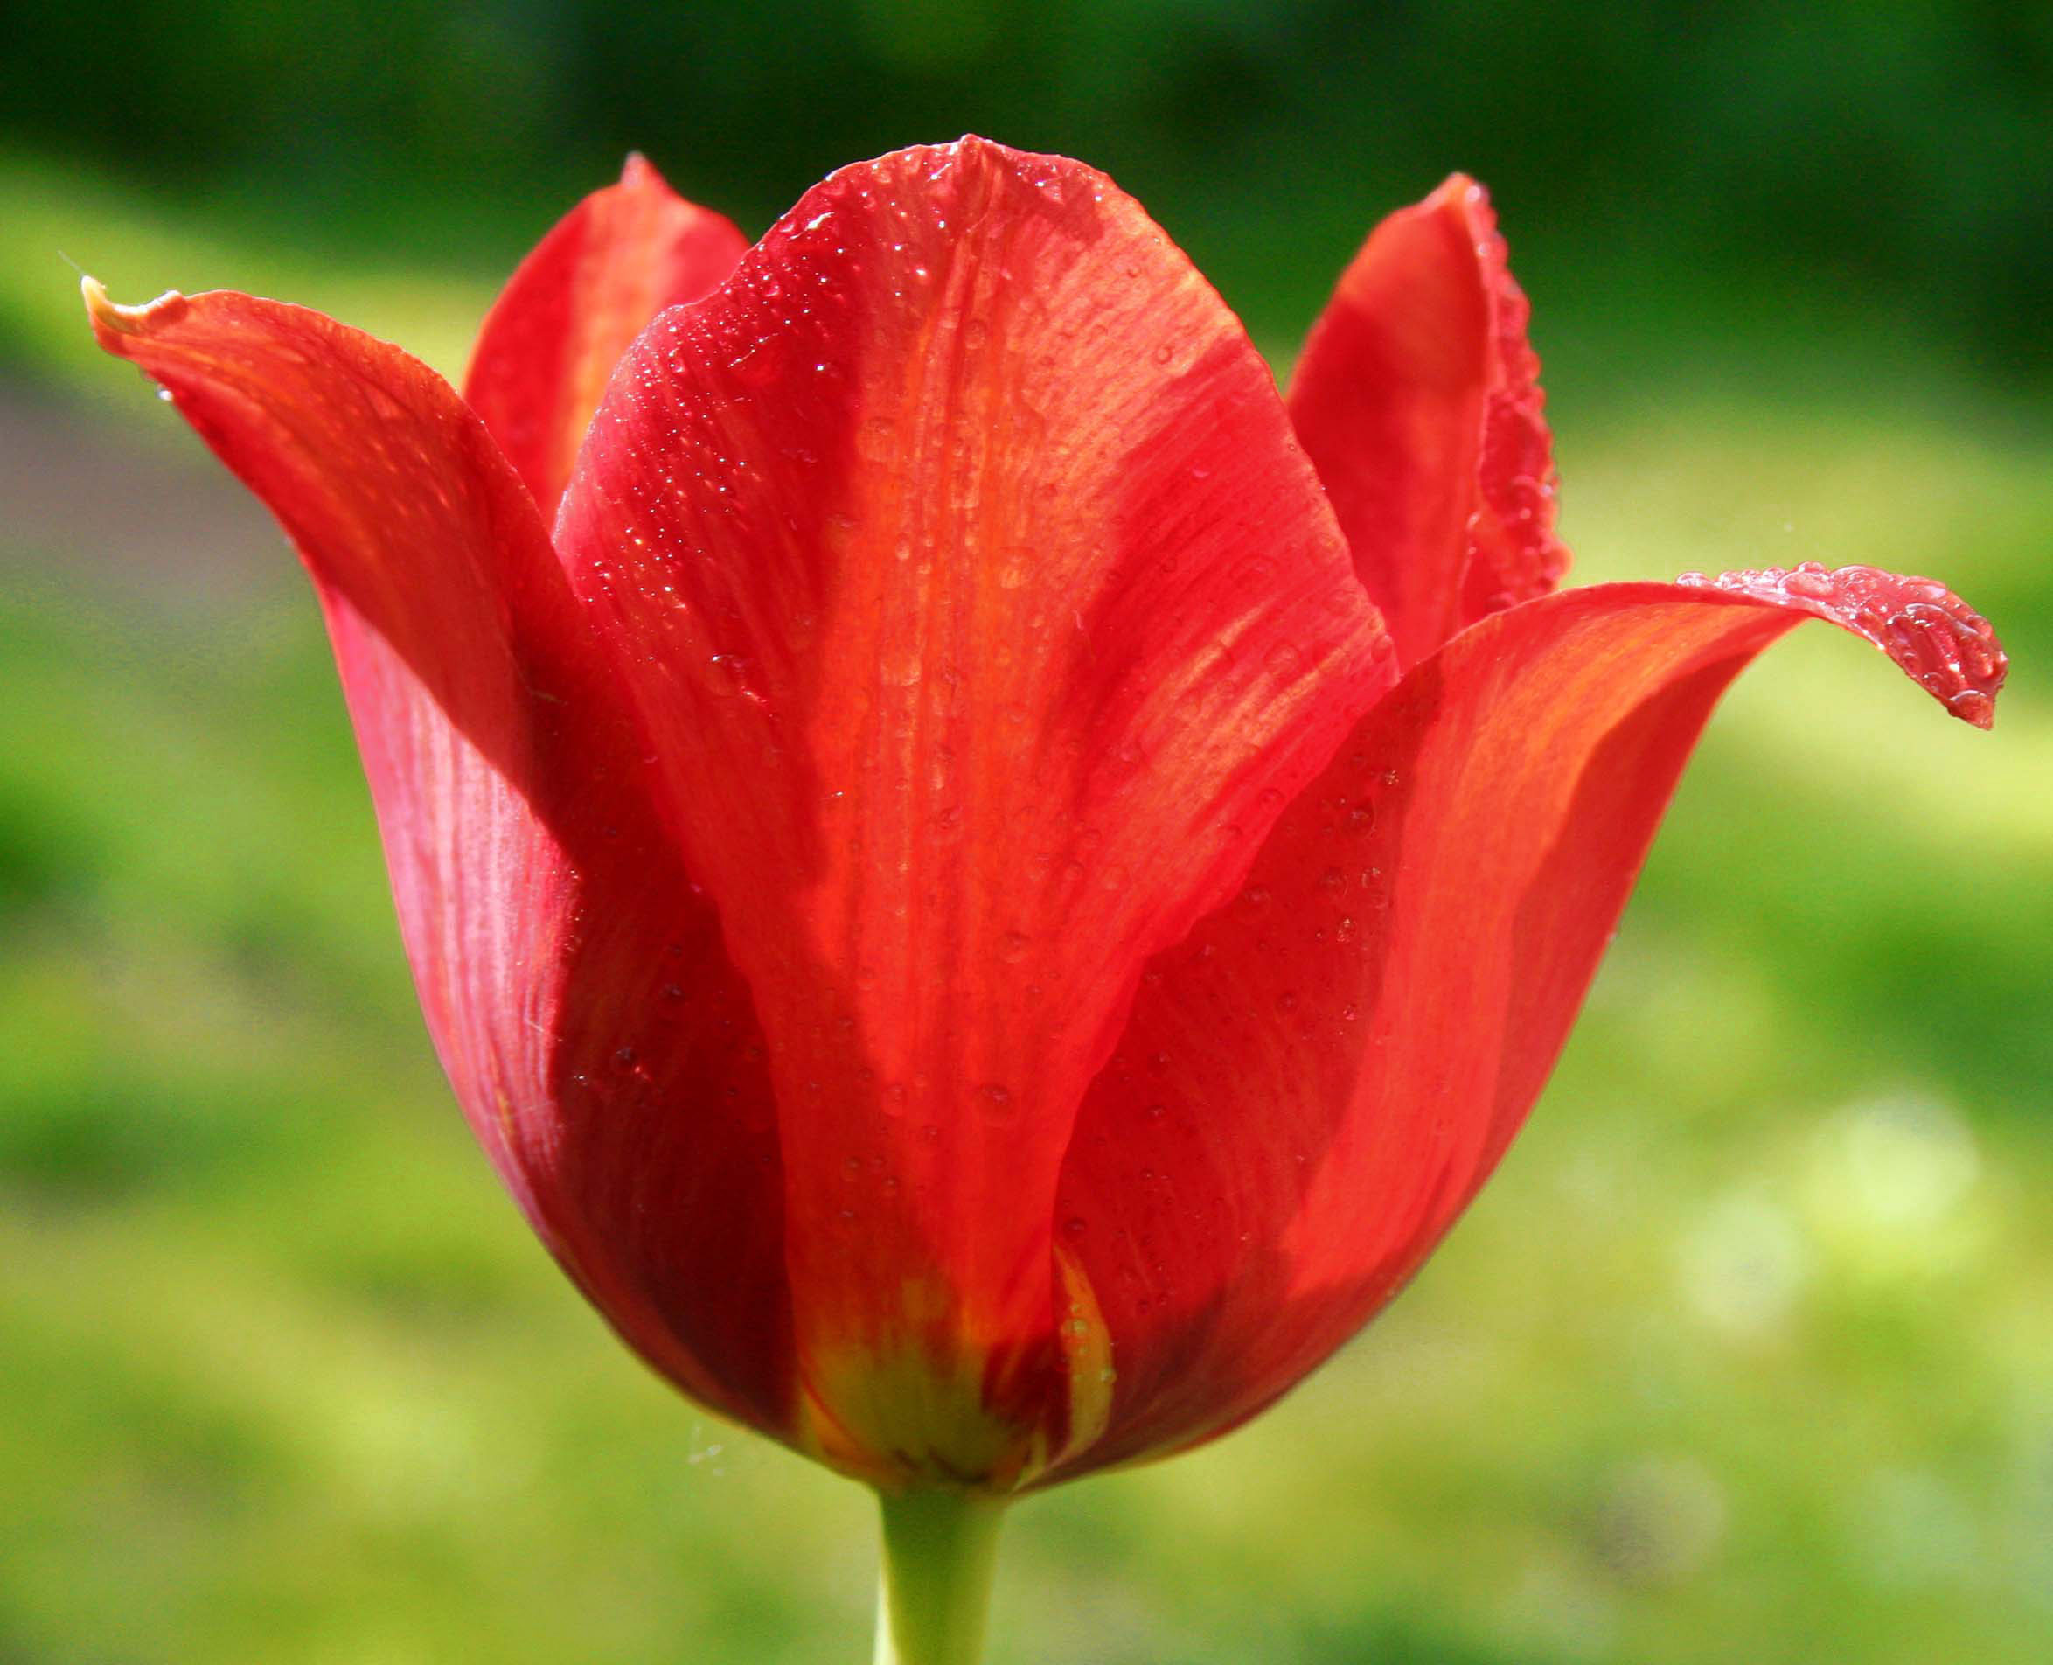
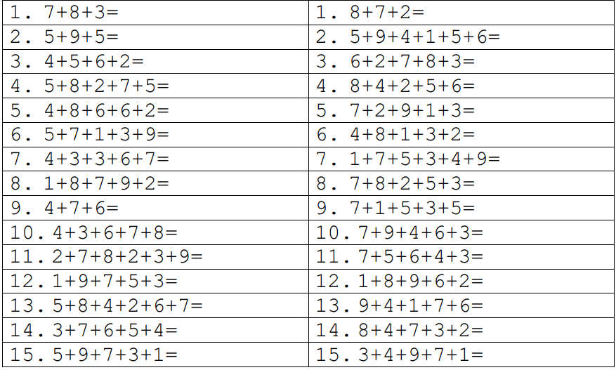
A
Tulip challenges
B

Slide 5
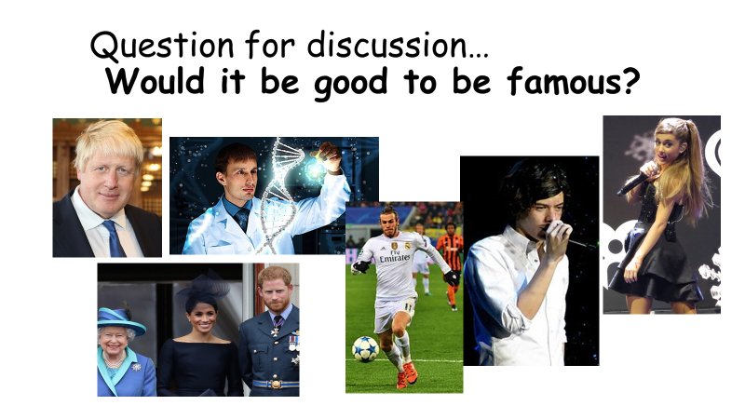
English Task
Write a discussion text using your notes from Friday. Please see next slide…

Slide 6
L.O. To write a discussion text.
Write the title: Would It be Good To Be Famous?
Introduce the discussion in the first paragraph (Some people think… )
Use the next few paragraphs (at least two) to explain some of the reasons ‘for’. Keep a formal tone.
Use the same number of paragraphs to write about some of the reasons ‘against’
Remember to balance the discussion!
Don’t forget to use connectives to give reasons why (see next slide)
Finally, write your opinion in the last paragraph

Slide 7
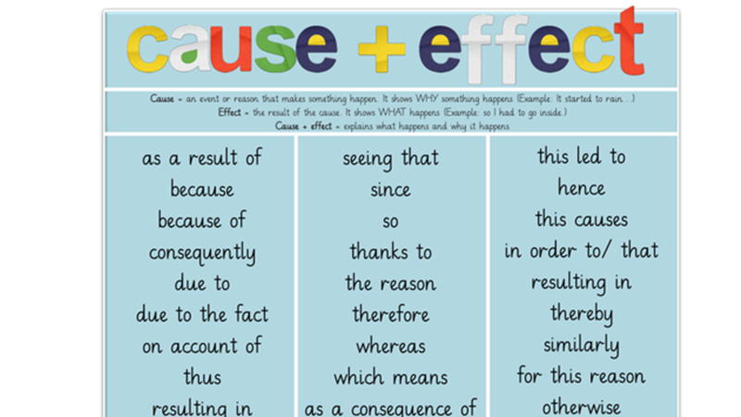

Slide 8
If you have time, why not illustrate your discussion text?
Please scan and send your completed
discussion text by email.
Thank you
Mrs. Langton and Mrs. Raper

